Slide 1
Lab 10: Numerical Integration (Chapter 19-20)
BME 313L: Introduction to Numerical Methods in Biomedical Engineering
Spring, 2017

Slide 2
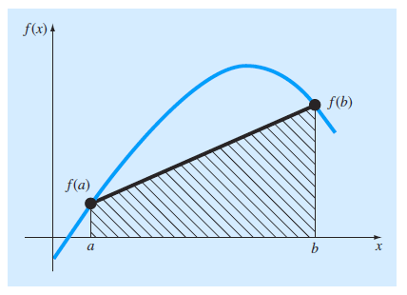
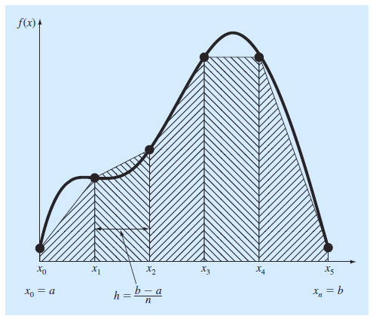
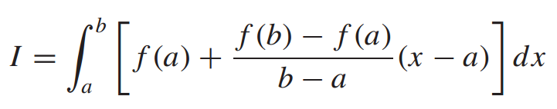
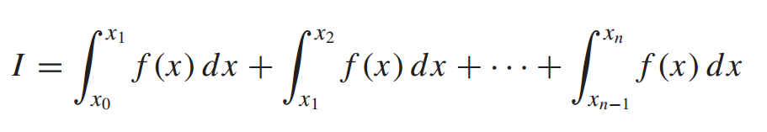

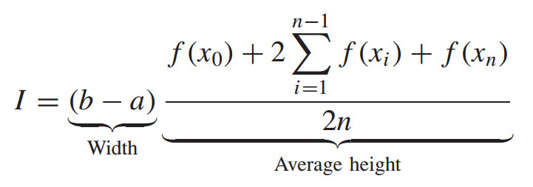
Single and composite trapezoidal rule
Single
Composite

Slide 3
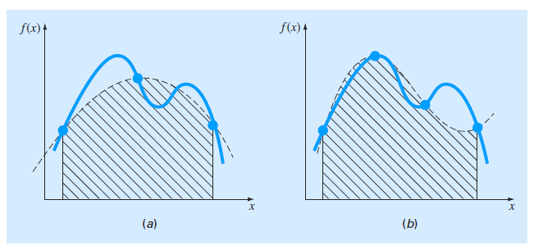
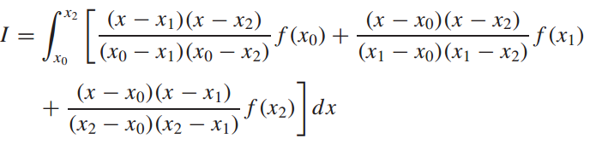



1/3 and 3/8 Simpson’s rule
1/3 Simpson’s Rule
3/8 Simpson’s Rule
Segment width:

Slide 4


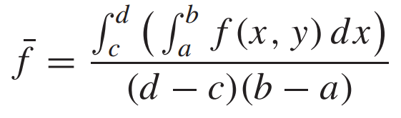
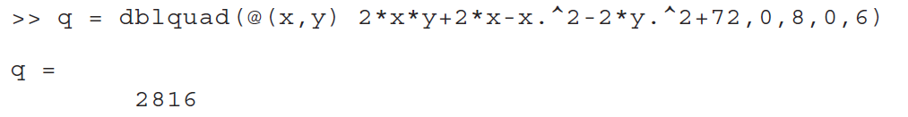
Integration with unequal segments
Matlab built-in function:
Multiple integrals
Matlab built-in function: dblquad; triplequad

Slide 5
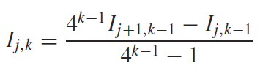
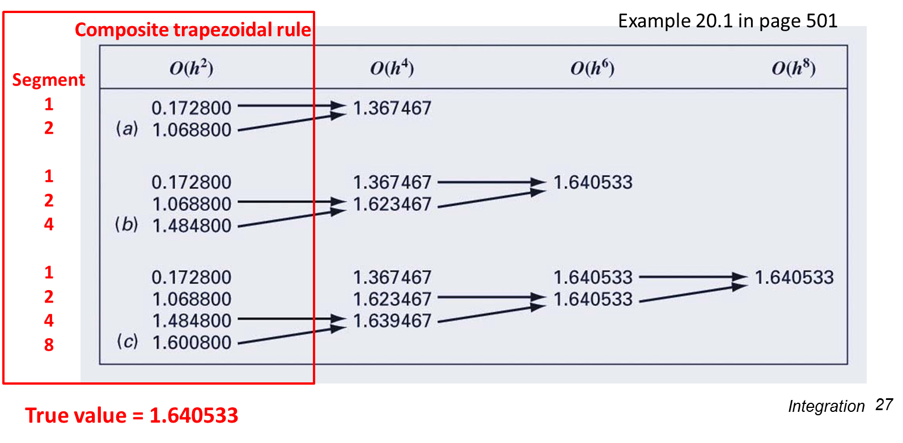
Romberg Integration
Richardson Extrapolation:
Efficient algorithm (trapezoidal rule based)
Use 2 less accurate results to get a more accurate result

Slide 6

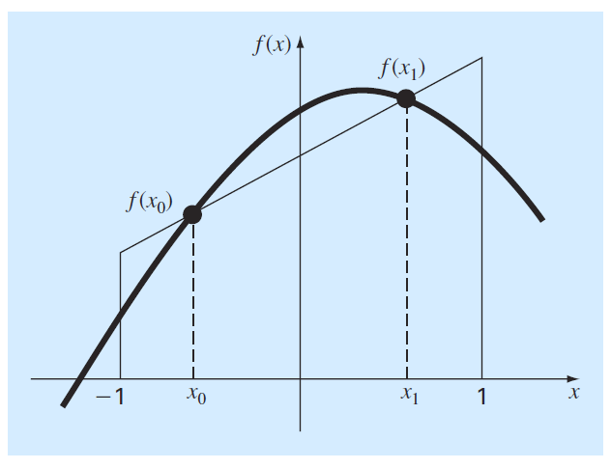
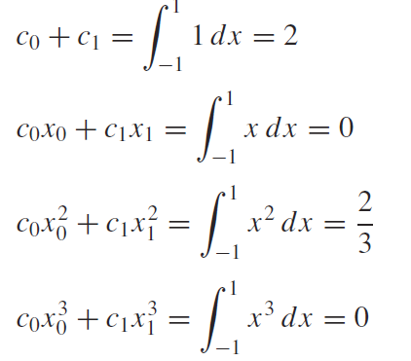
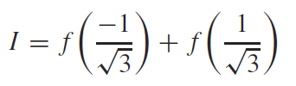
Gauss Quadrature

Slide 7



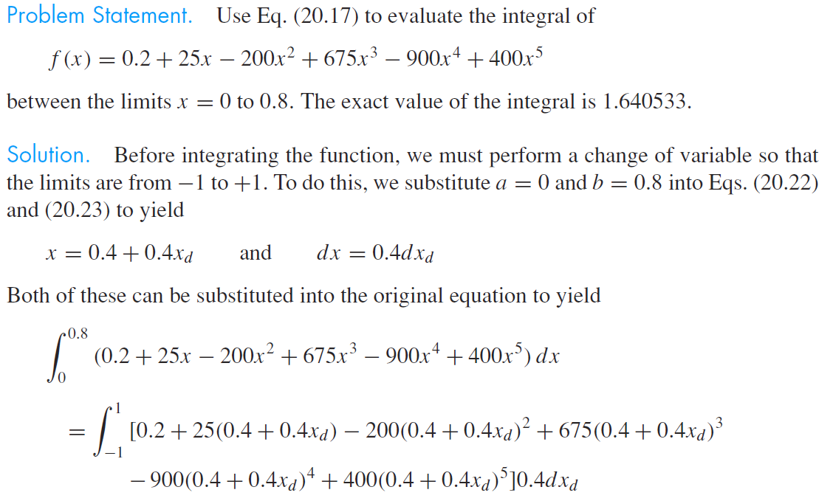
What if x is out side of [-1,1]?

Slide 8
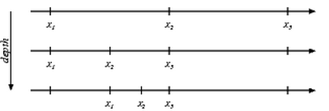


Adaptive Quadrature
Based on 1/3 Simpson’s rule
Each subinterval meets the specified accuracy
At each level of refinement, error will be calculated
If error is small enough, new estimate will be calculated as
Matlab built-in function: quad/quadl

Slide 9
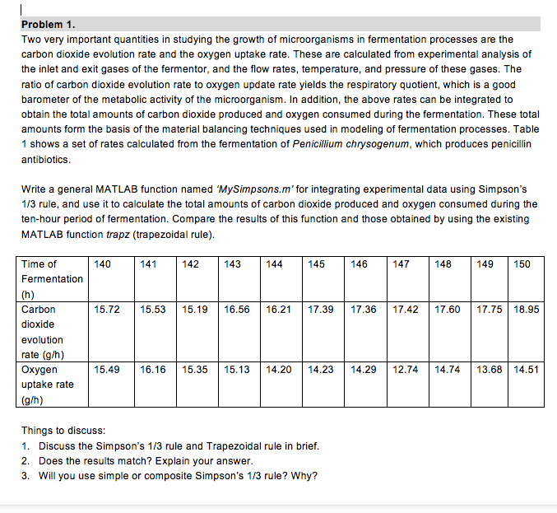

Slide 10
